Slide 1

MindDish.ai
Multimodal RAG-Based Cooking Assistant
AI Engineering Bootcamp Project • Ironhack 2025

Slide 2

The Challenge: Cooking in the Digital Age
Video Friction
Following YouTube cooking tutorials requires constant pausing, rewinding, and searching—disrupting the natural flow of cooking.
Language Barriers
Authentic global recipes often lack multilingual support, limiting access to diverse culinary traditions and techniques.
No Interactive Help
Traditional videos can't answer questions about ingredient substitutions, timing adjustments, or technique clarifications in real-time.
Missing Context
Users struggle to find specific information within long videos, wasting valuable time when they need quick answers.

Slide 3

Introducing MindDish.ai
An intelligent cooking companion that transforms how people learn and cook from video recipes, powered by advanced RAG technology and multimodal AI.
Intelligent Recipe Analysis
Multilingual & Adaptive
Curated collection of 28 cooking videos spanning 7 distinct cuisines—from African to Italian—processed into searchable, conversational knowledge.
Supports English, Portuguese, Spanish, French, and Nigerian languages. Provides instant answers, ingredient substitutions, and safety-verified recommendations.

Slide 4
Technical Architecture
01
02
03
Data Ingestion
Vector Storage
RAG Pipeline
28 curated cooking videos processed and chunked into 240 semantic segments for optimal retrieval
ChromaDB vectorstore with OpenAI text-embedding-3-small for lightning-fast similarity search
GPT-3.5-turbo orchestrates 17 specialized tools including Tavily web search for expanded knowledge
04
05
API Layer
User Interface
FastAPI backend handles requests, manages sessions, and ensures secure communication
Next.js frontend deployed at minddish.ai provides seamless, responsive cooking assistance

Slide 5
Powerful Features That Stand Out
3-Layer Safety System
Multi-Cuisine Support
Permission-Based Search
Contextual Memory
Ingredient substitutions verified through multiple safety checks to prevent allergic reactions and ensure culinary success.
Seven distinct culinary traditions: African, French, Portuguese, Jamaican, Syrian, Italian, and Indian cuisines.
Session-based conversation history remembers your questions and preferences throughout the cooking journey.
User-controlled web search integration via Tavily API expands knowledge beyond the recipe database when needed.
Source Attribution
Every response includes clear source references, ensuring transparency and building trust in AI recommendations.

Slide 6


Evaluation Results: Performance Excellence
92.9%
Accuracy Rate
Consistently accurate responses across diverse queries
1.77s
Response Time
Lightning-fast answers for seamless cooking experience
100%
Accuracy
Remaining
Test Pass Rate
Comprehensive evaluation suite validates reliability
Rigorous testing across multiple cuisines, languages, and query types confirms MindDish.ai delivers professional-grade assistance with exceptional speed and accuracy.

Slide 7
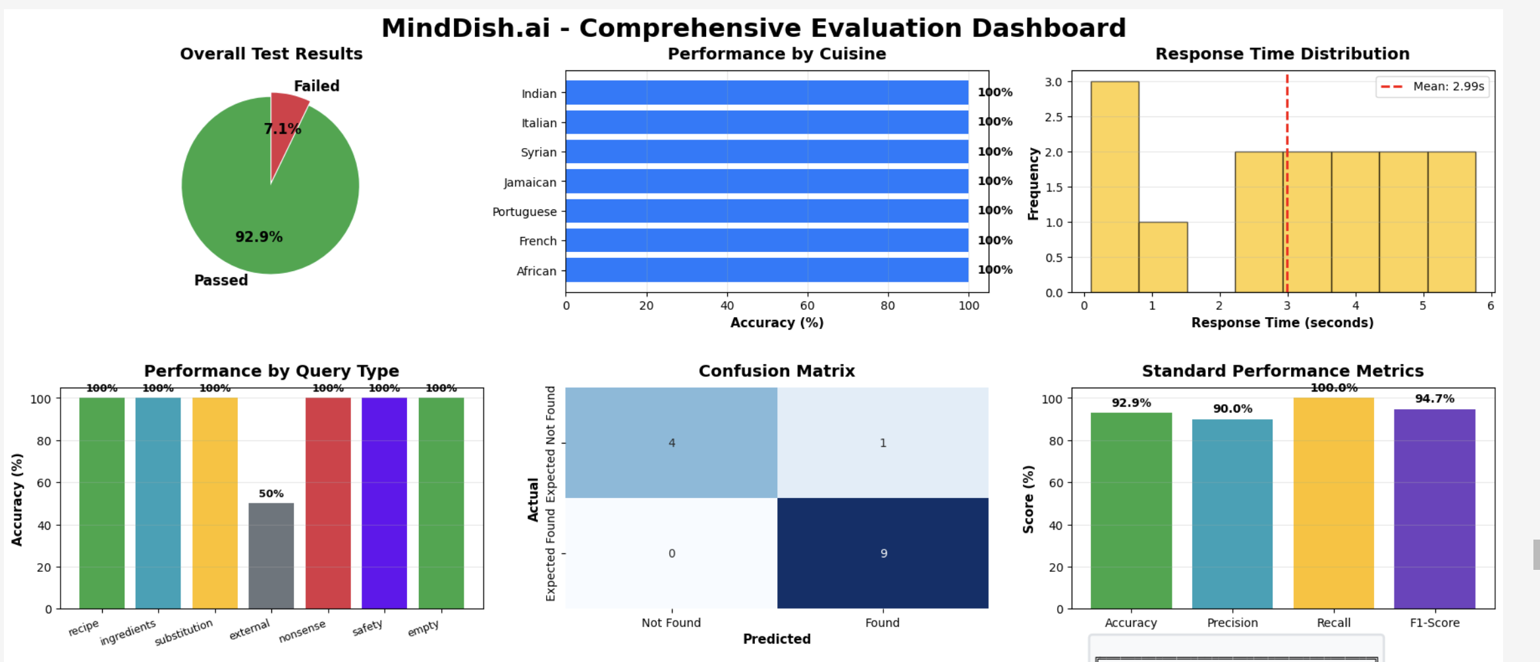

Slide 8
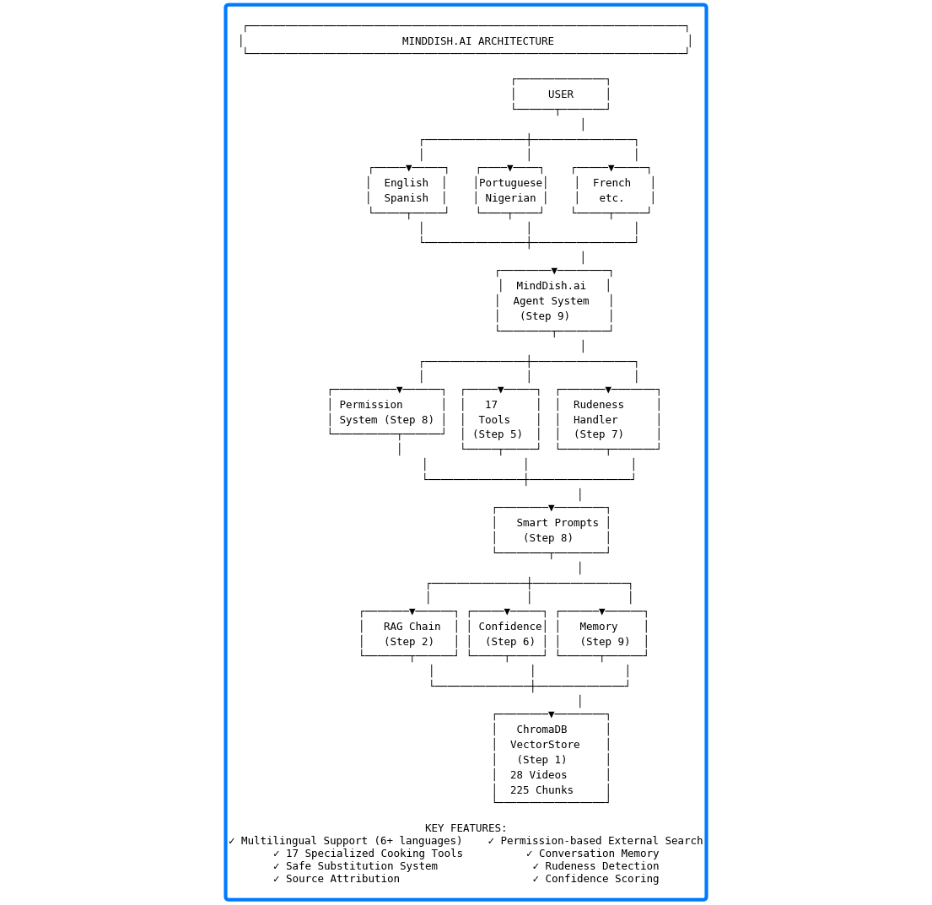

Slide 9




Overcoming Technical Challenges
YouTube IP Blocking
Challenge: Direct video access repeatedly blocked
Solution: Implemented YouTube Transcript API for reliable data extraction
API Key Security
Challenge: Protecting sensitive credentials in production
Solution: Environment variables managed through Render deployment platform
ChromaDB Deployment
Challenge: Vector database initialization in cloud environment

Slide 10




Vision for the Future
MindDish.ai represents just the beginning of AI-powered culinary assistance. The roadmap ahead focuses on expansion, accessibility, and enhanced user experience.
Expanded Cuisine Library
Voice Integration
Add 50+ more videos covering Asian, Middle Eastern, and Latin American cooking traditions
Hands-free operation with voice input and audio responses for truly seamless cooking
Native Mobile App
Meal Planning AI
iOS and Android applications with offline mode and kitchen timer integration
Weekly menu generation with shopping lists and nutritional tracking capabilities

Slide 11

Thank You
Questions?
Experience MindDish.ai live at minddish.ai
Built with passion for cooking and AI engineering

